Slide 1


Bird-watcher-
1st-Year:-

Slide 2
Manjot-kaur
Bsc-med-2nd year

Slide 3
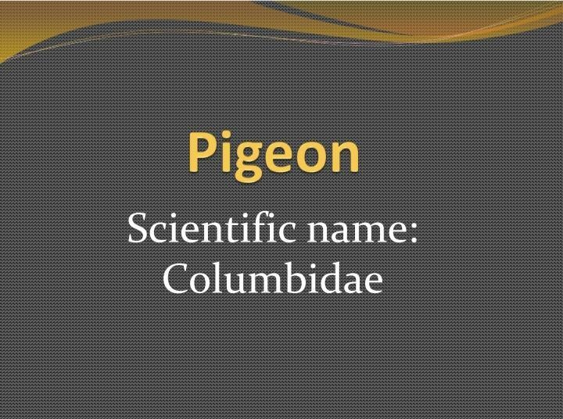
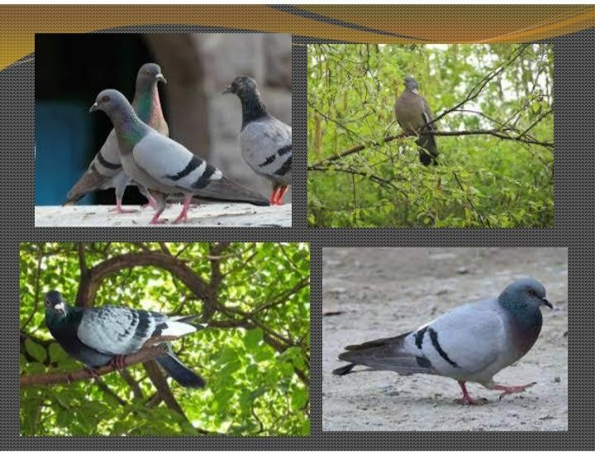

Slide 4
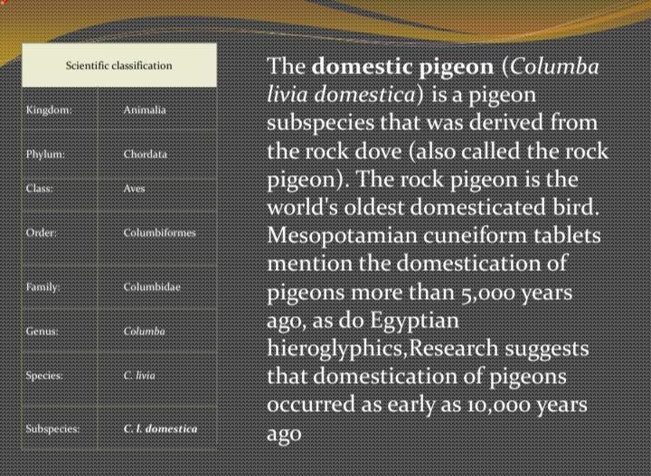

Slide 5
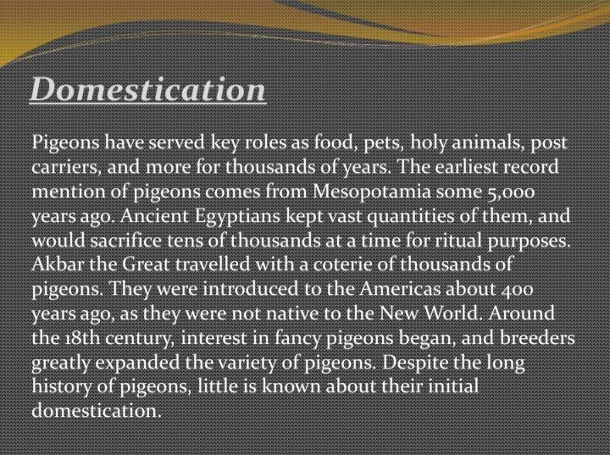
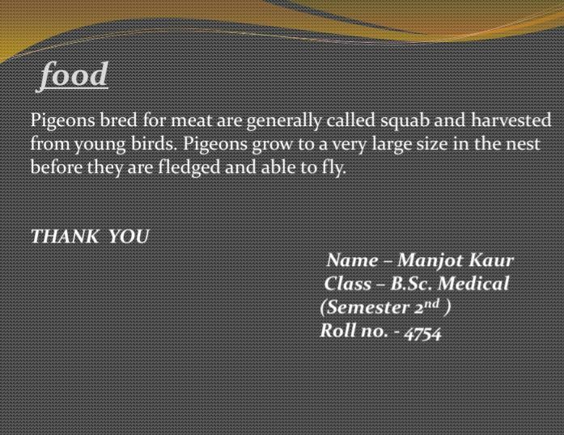

Slide 6
Saloni
Bsc non med. 1st year

Slide 7
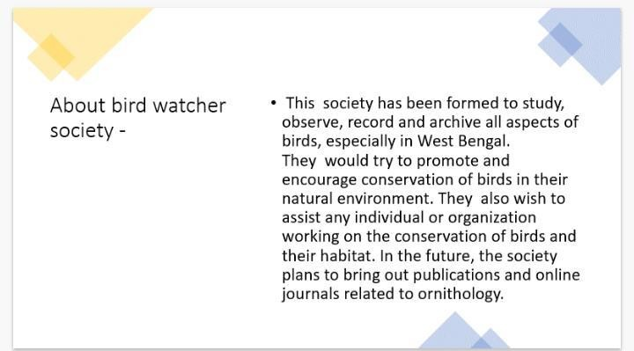
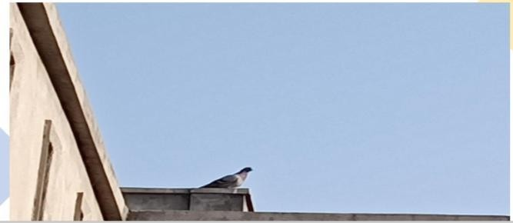

Slide 8
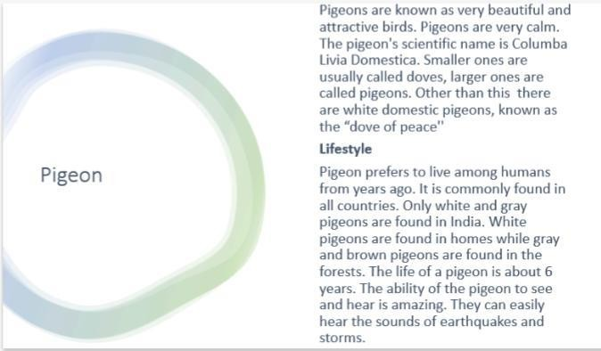

Slide 9
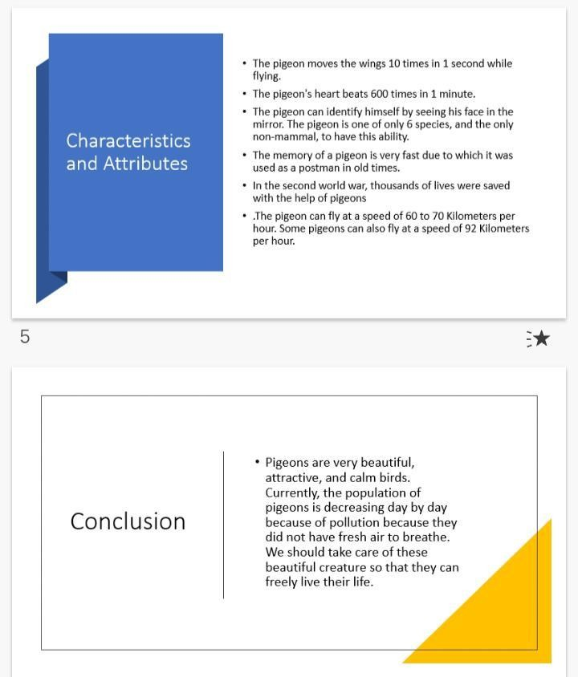

Slide 10
Sonia
Bsc non med. 1st year

Slide 11
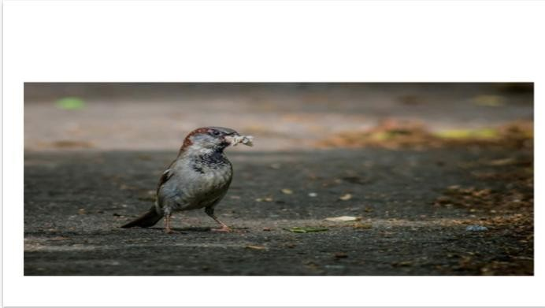
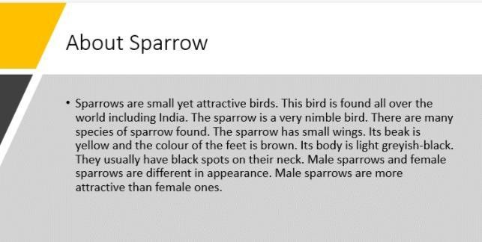

Slide 12
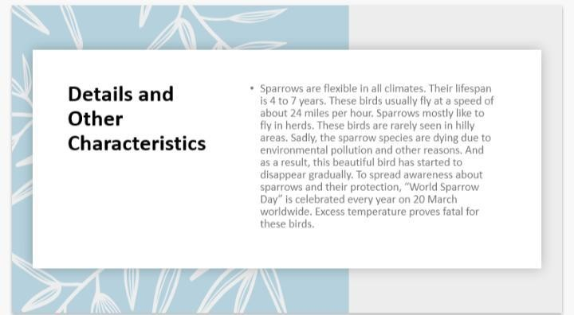
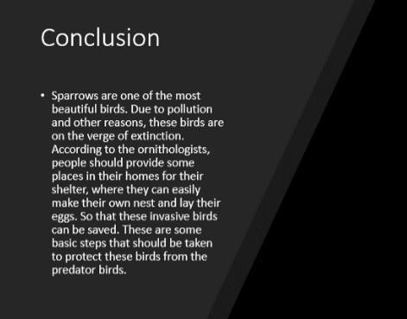

Slide 13
Kariti
Bsc.non.med.1st year

Slide 14
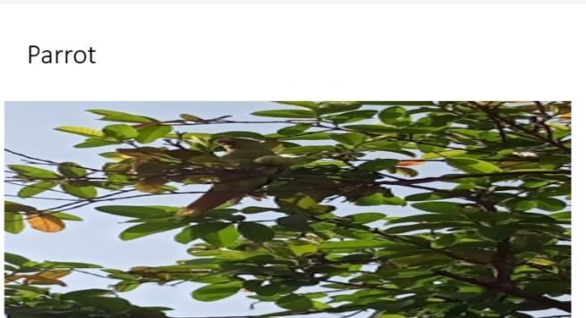
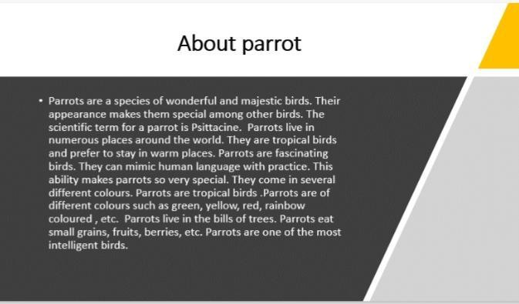

Slide 15
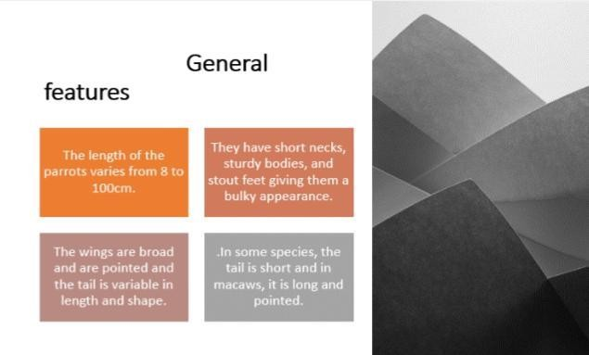
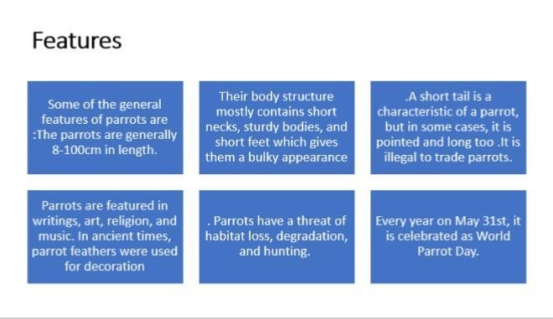

Slide 16
CROW

Slide 17
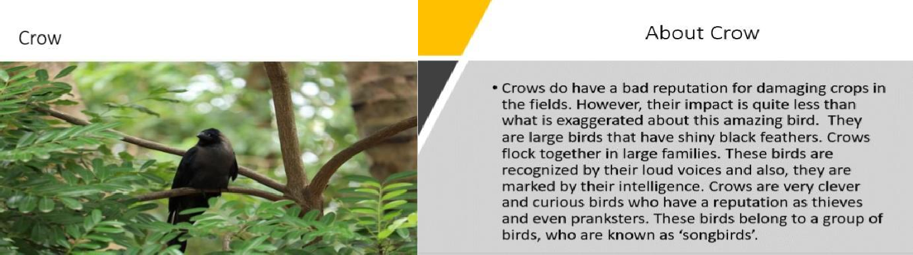

Slide 18
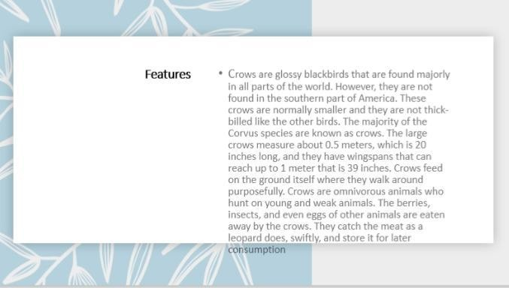


Slide 19
2nd year:-

Slide 20
Harleen
Bsc-med-2nd year

Slide 21
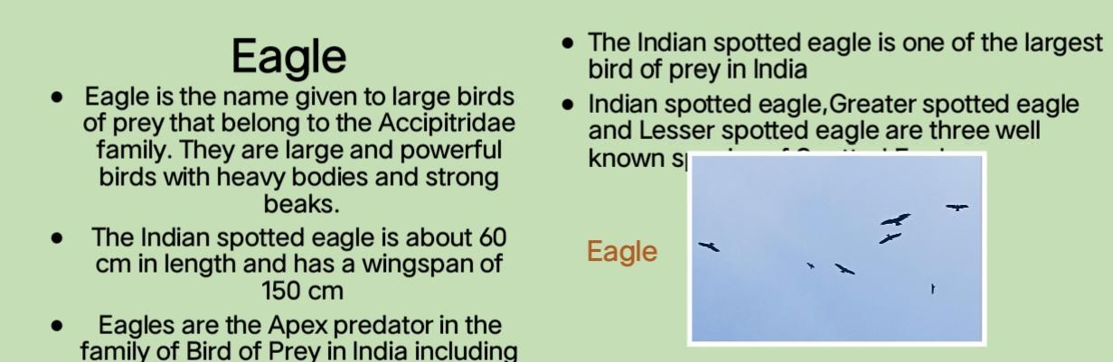

Slide 22
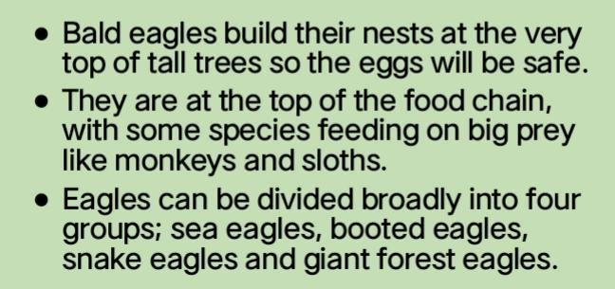
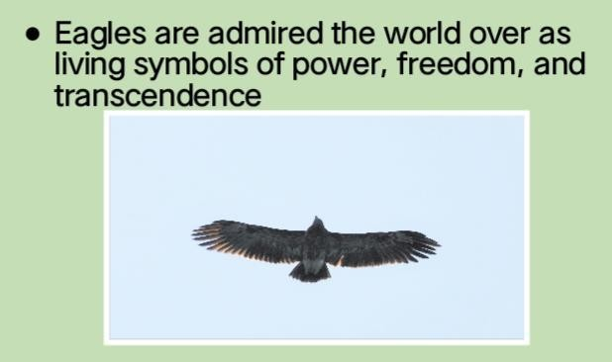
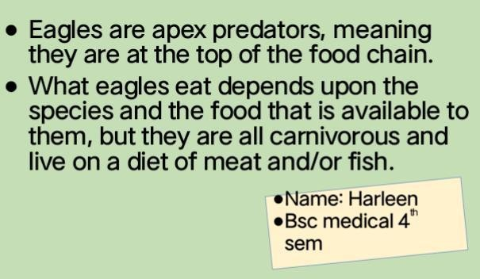

Slide 23
Simranjit
Bsc med. 2nd year

Slide 24
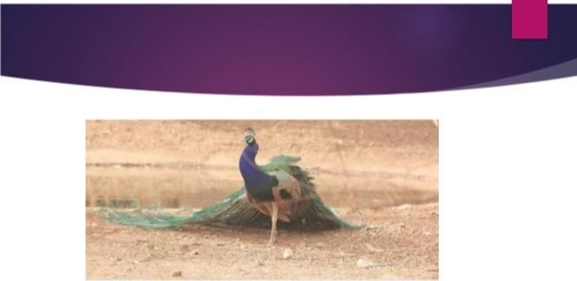
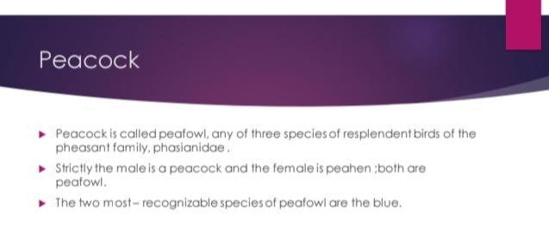

Slide 25
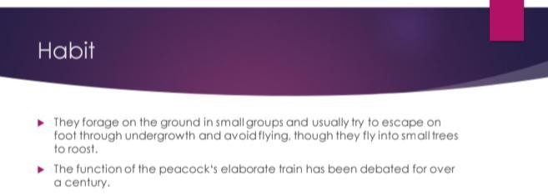
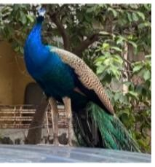


Slide 26
Gaganpreet
Bsc med. 2nd year

Slide 27
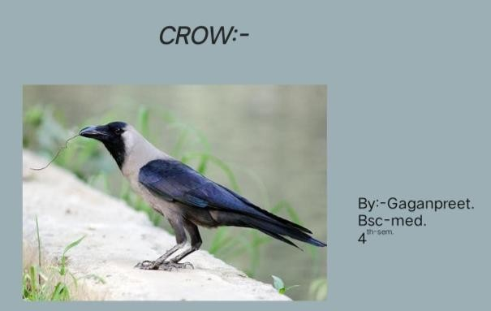
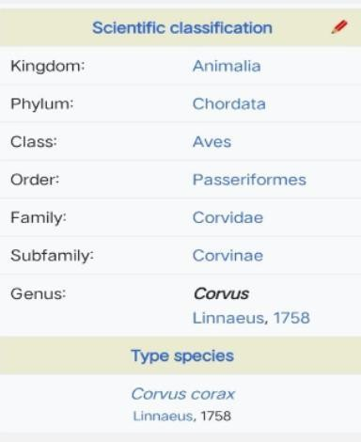

Slide 28
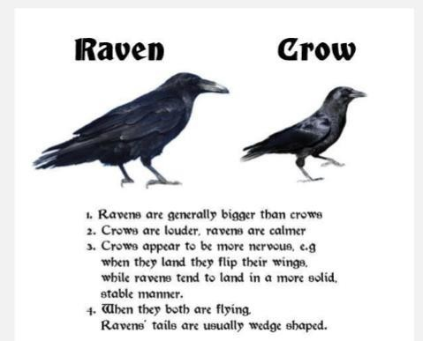
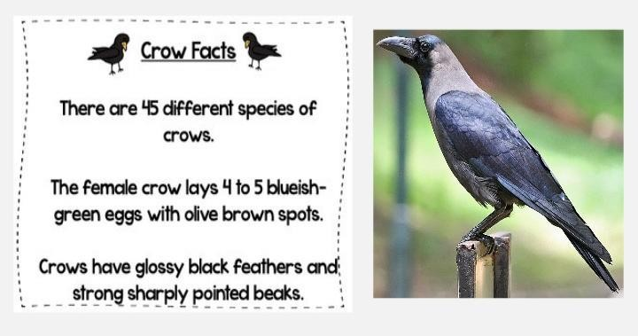

Slide 29
Manroop kaur
Bsc med. 2nd year

Slide 30

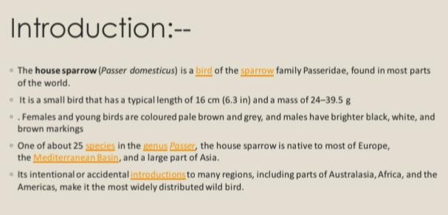

Slide 31
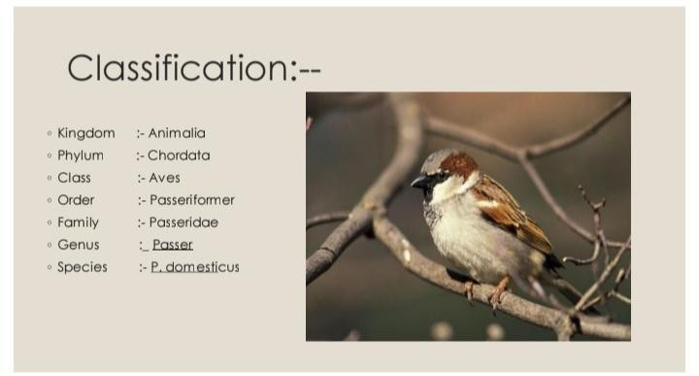
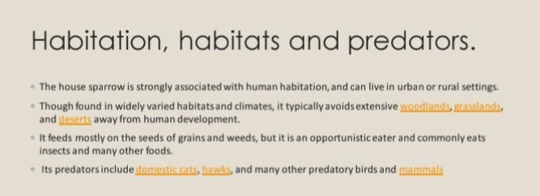

Slide 32
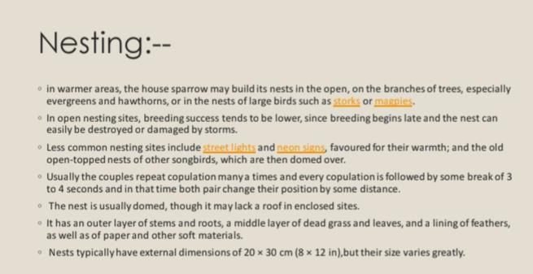
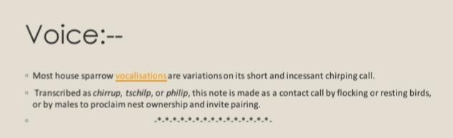

Slide 33
Isha
Bsc med. 2nd year

Slide 34
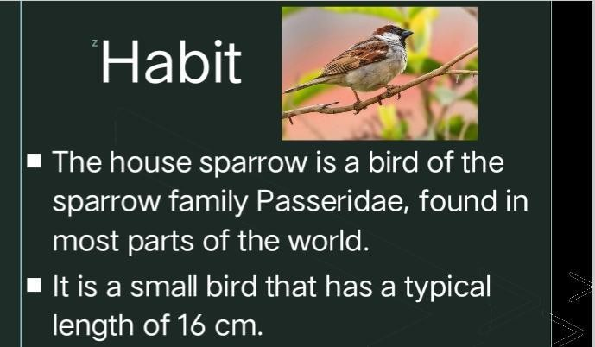
Bird Watcher
Sparrow

Slide 35
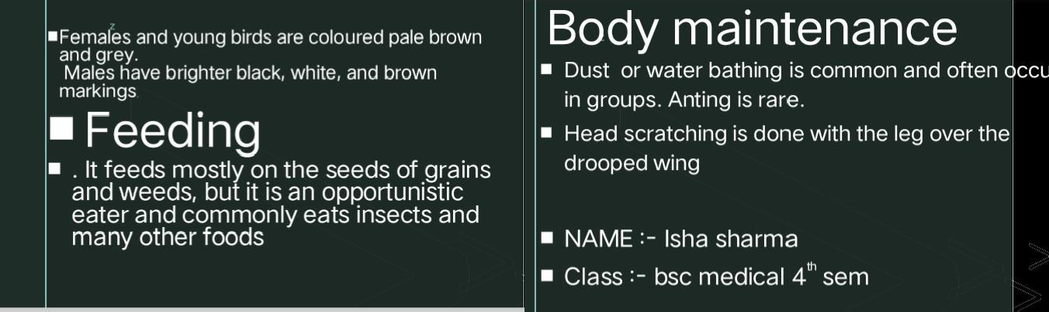

Slide 36
₃rd-Year:-

Slide 37
Pooja kumari
Bsc non med. 3rd year

Slide 38
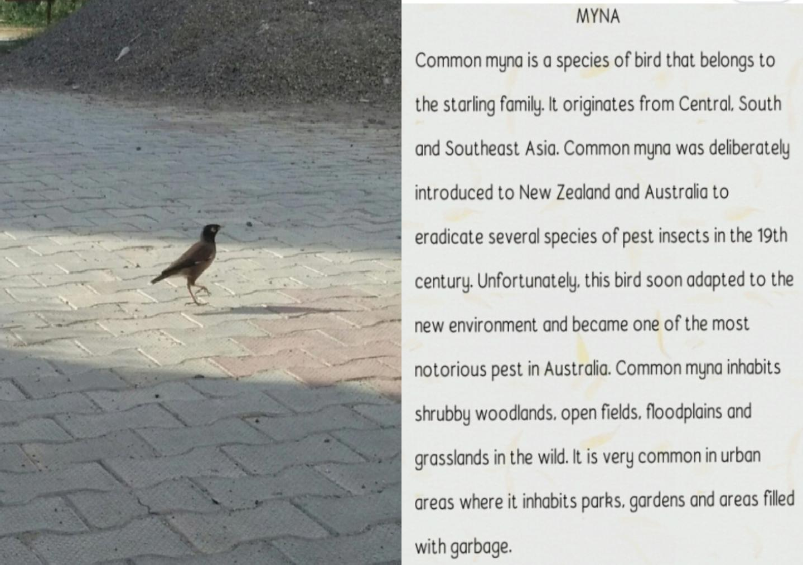

Slide 39
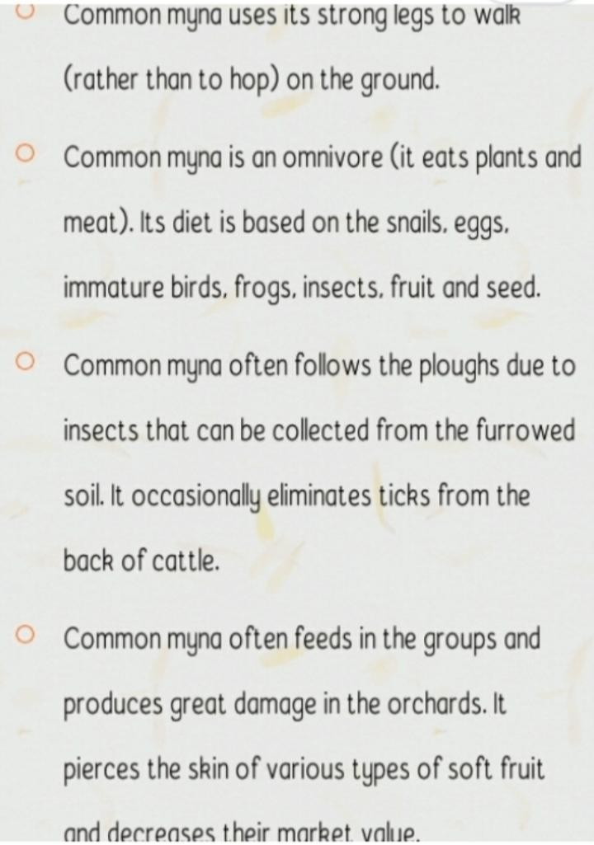
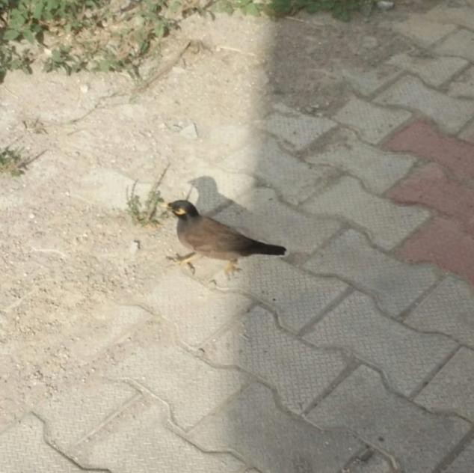

Slide 40
Manisha ranga
Bsc non med. 3rd year

Slide 41
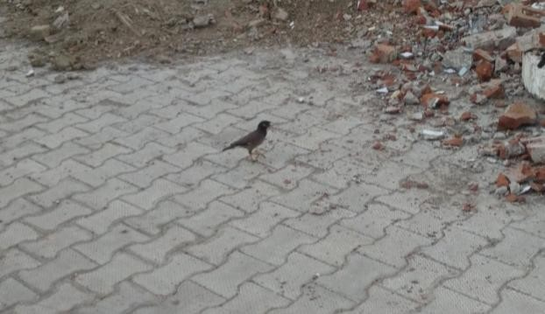
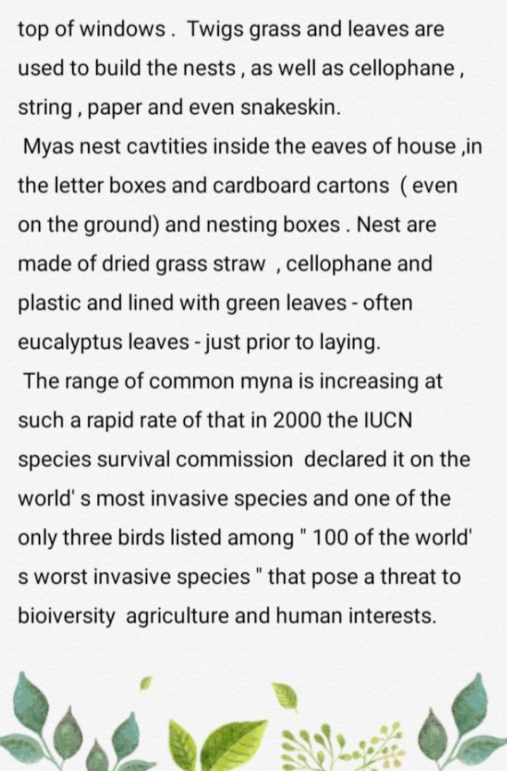

Slide 42
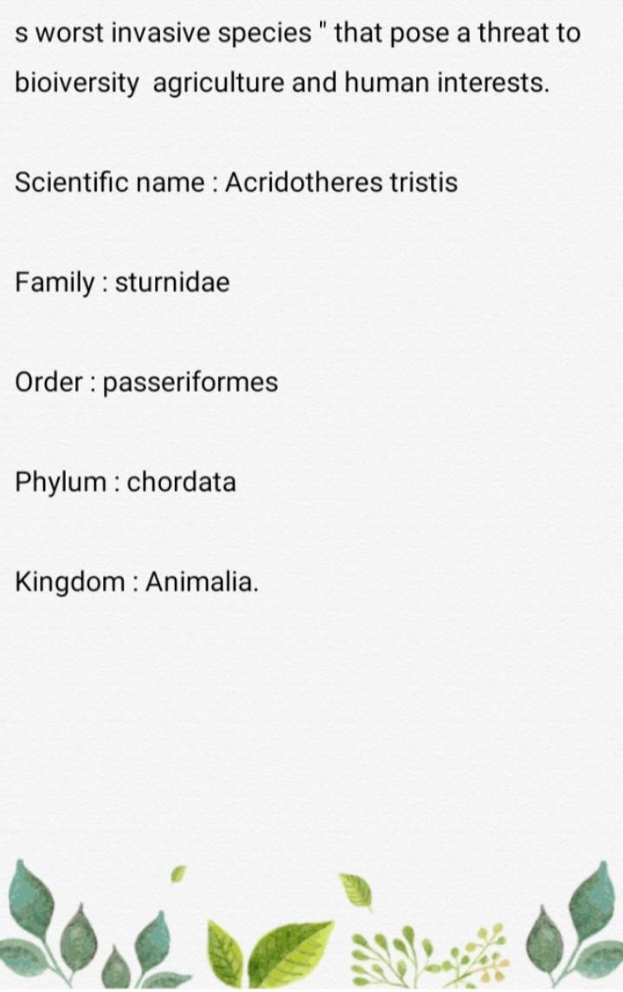
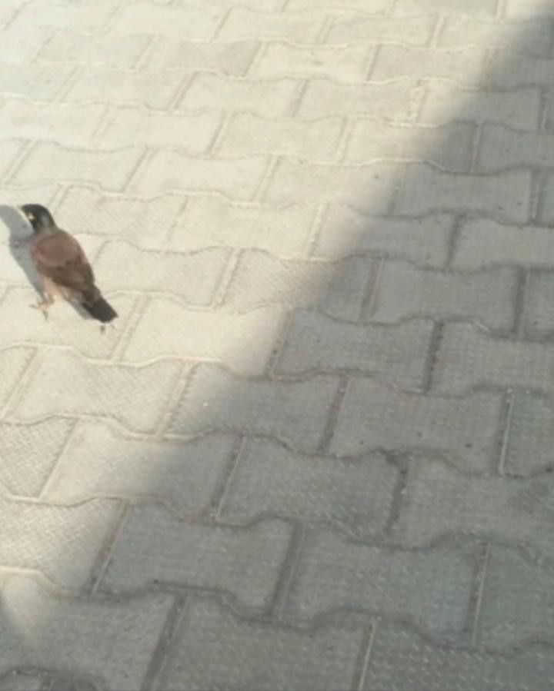

Slide 43
Rajvir kaur
Bsc comp. Sci. 3rd year

Slide 44
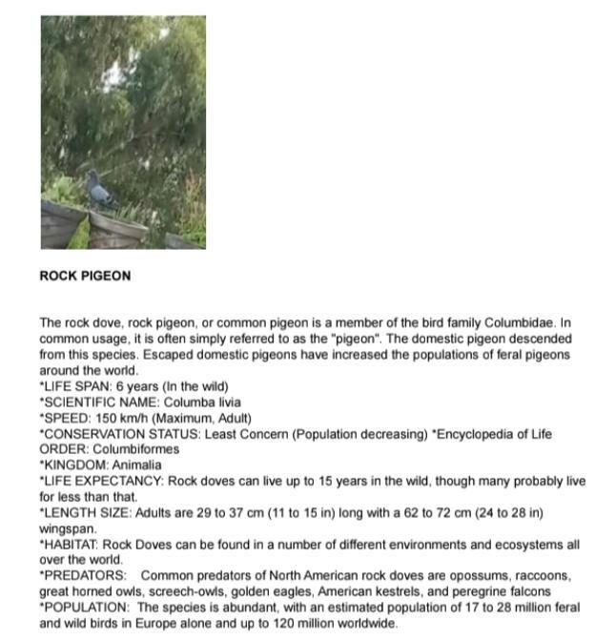

Slide 45
Jasmeen kaur
Bsc non-med. 3rd year

Slide 46
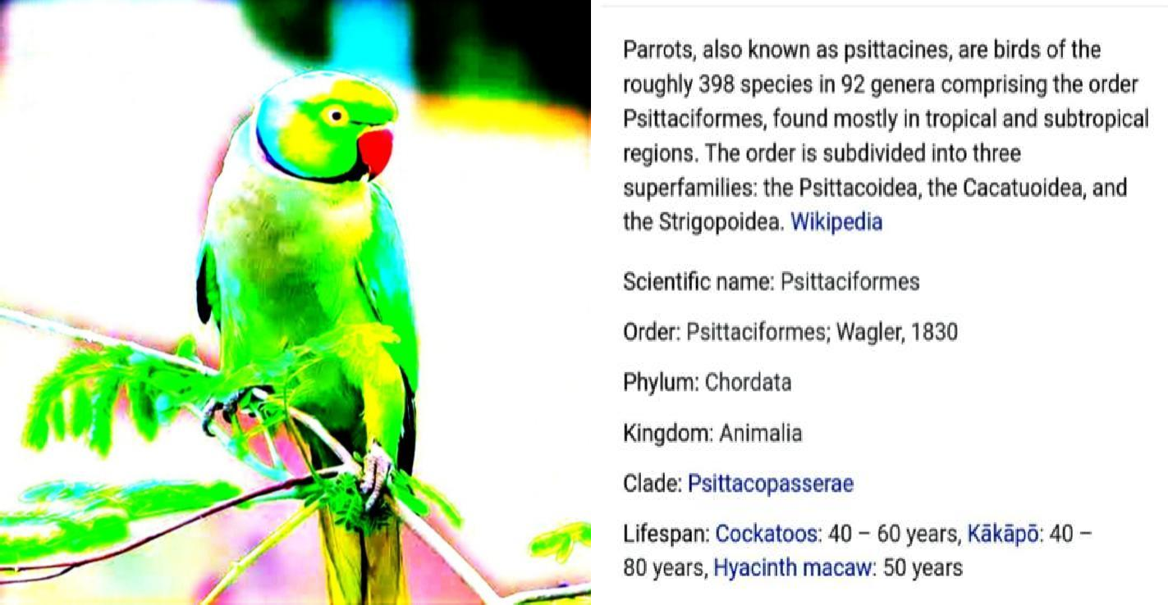

Slide 47
Lakshmi kumari
Bsc 3rd year

Slide 48
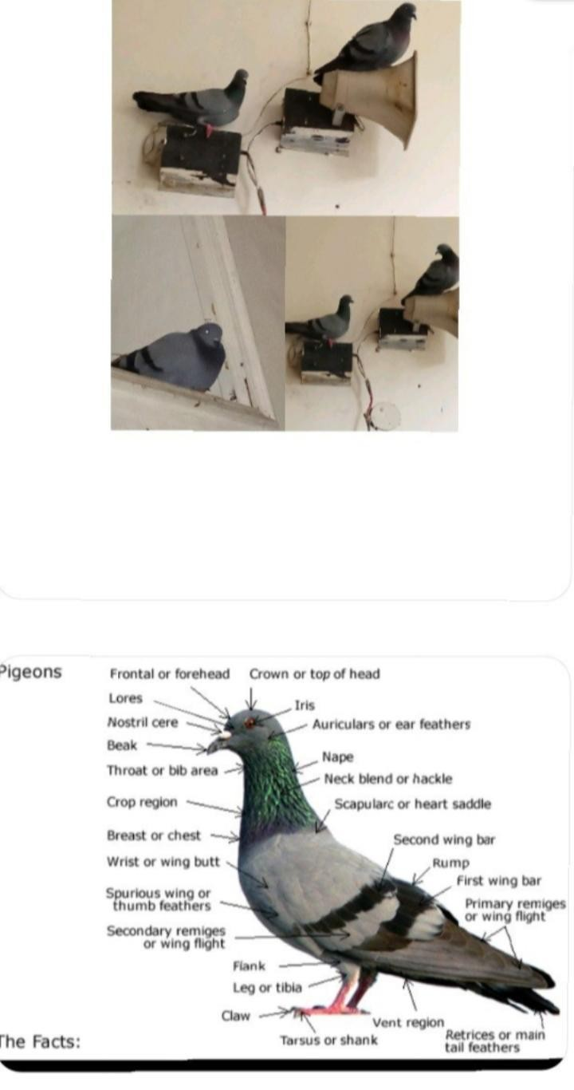

Slide 49
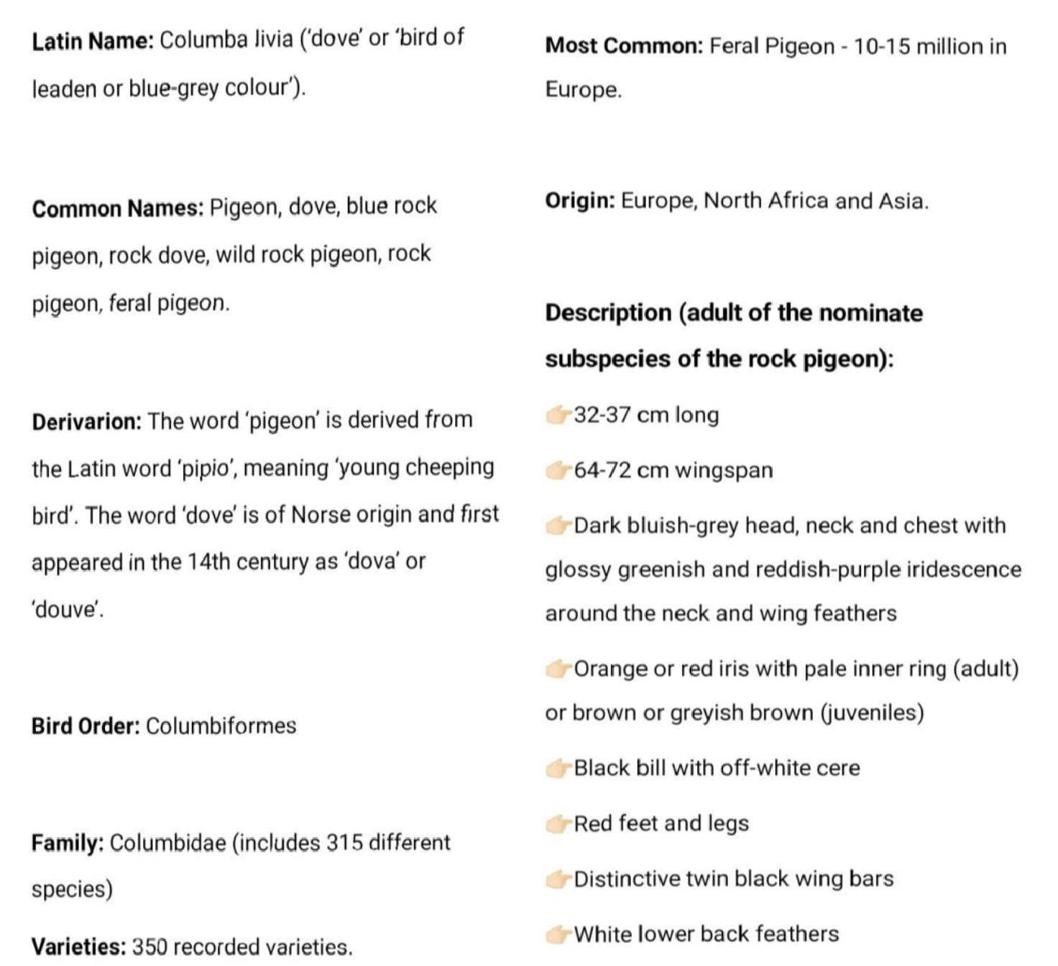

Slide 50
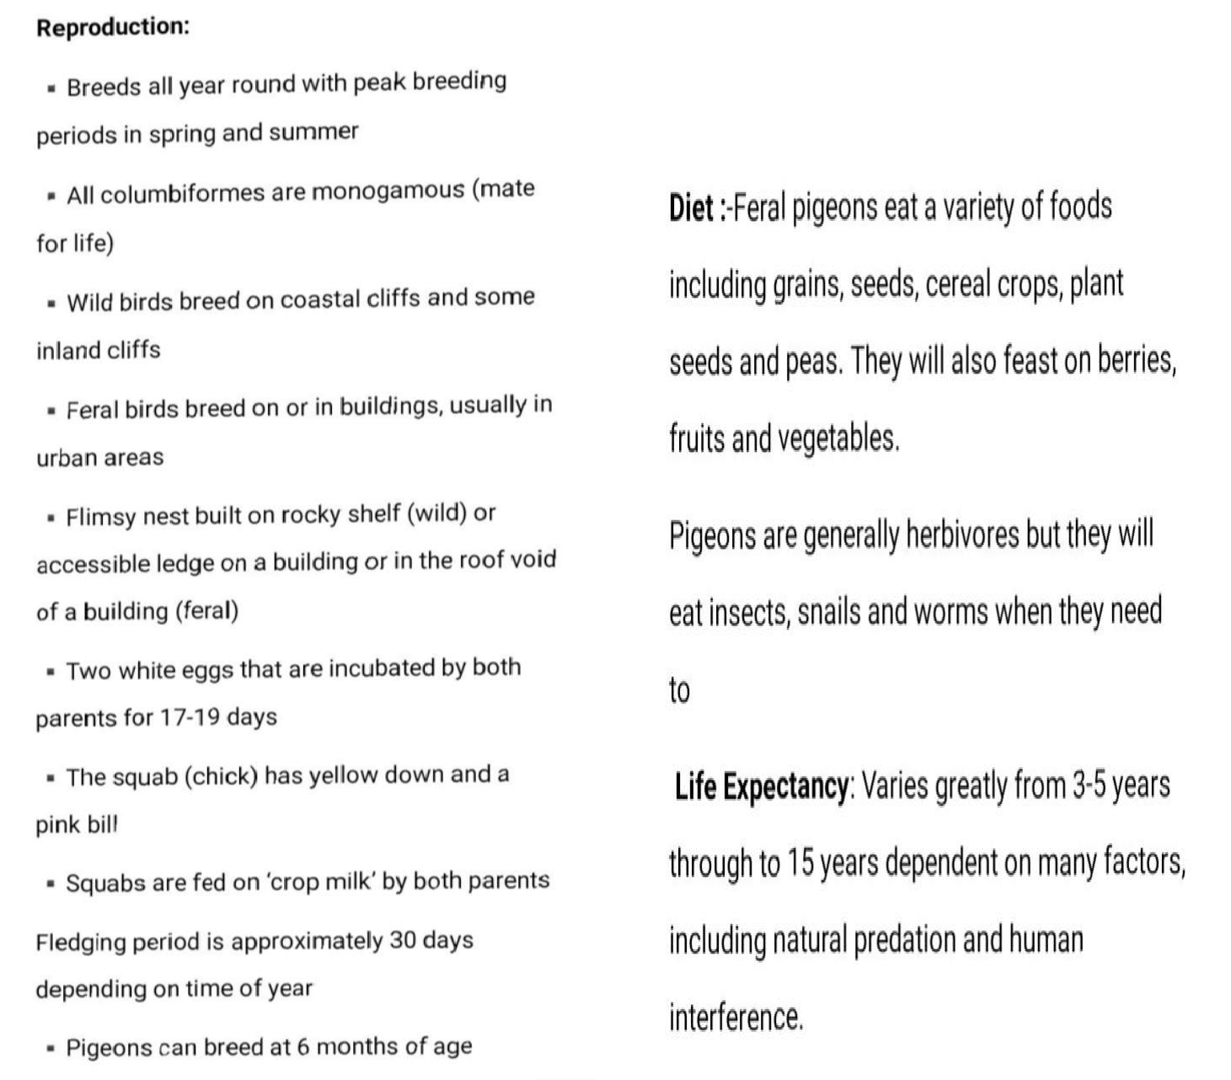

Slide 51
Amanjot kaur
Bsc non. Med. 3rd year

Slide 52


Slide 53
Mandeep kaur
Bsc comp. Sci. 3rd year.

Slide 54



Slide 55


Slide 56
Payal sharma
Bsc med-3rd year

Slide 57



Slide 58


Slide 59
Thank-You.

